Slide 1
Web(tried to) Scraping indeed.com Ended up Scraping dice.com
ARDA BERKAY KOSAR

Slide 2
Outline
Initial Plan
Result
What was wrong about Indeed
What was right about Dice
The Scraped Data

Slide 3
Initial Plan
Scraping indeed.com
Extracting job title, company name, company rating, job description, salary information
“Data Scientist” jobs in NYC
Exploratory Data Analysis

Slide 4
Result
Scraped dice.com
Extracted job title, company name, job type, location, salary information
For “Data Scientist” jobs in NYC for 25 mile radius
Tried to do some EDA

Slide 5
What was wrong with Indeed?
Unstructured html
Too many different tags
Sponsored jobs with linked company name
Sponsored jobs with not linked company name
Regular job with linked company name
Regular job with not linked company name
Different job description pages

Slide 6
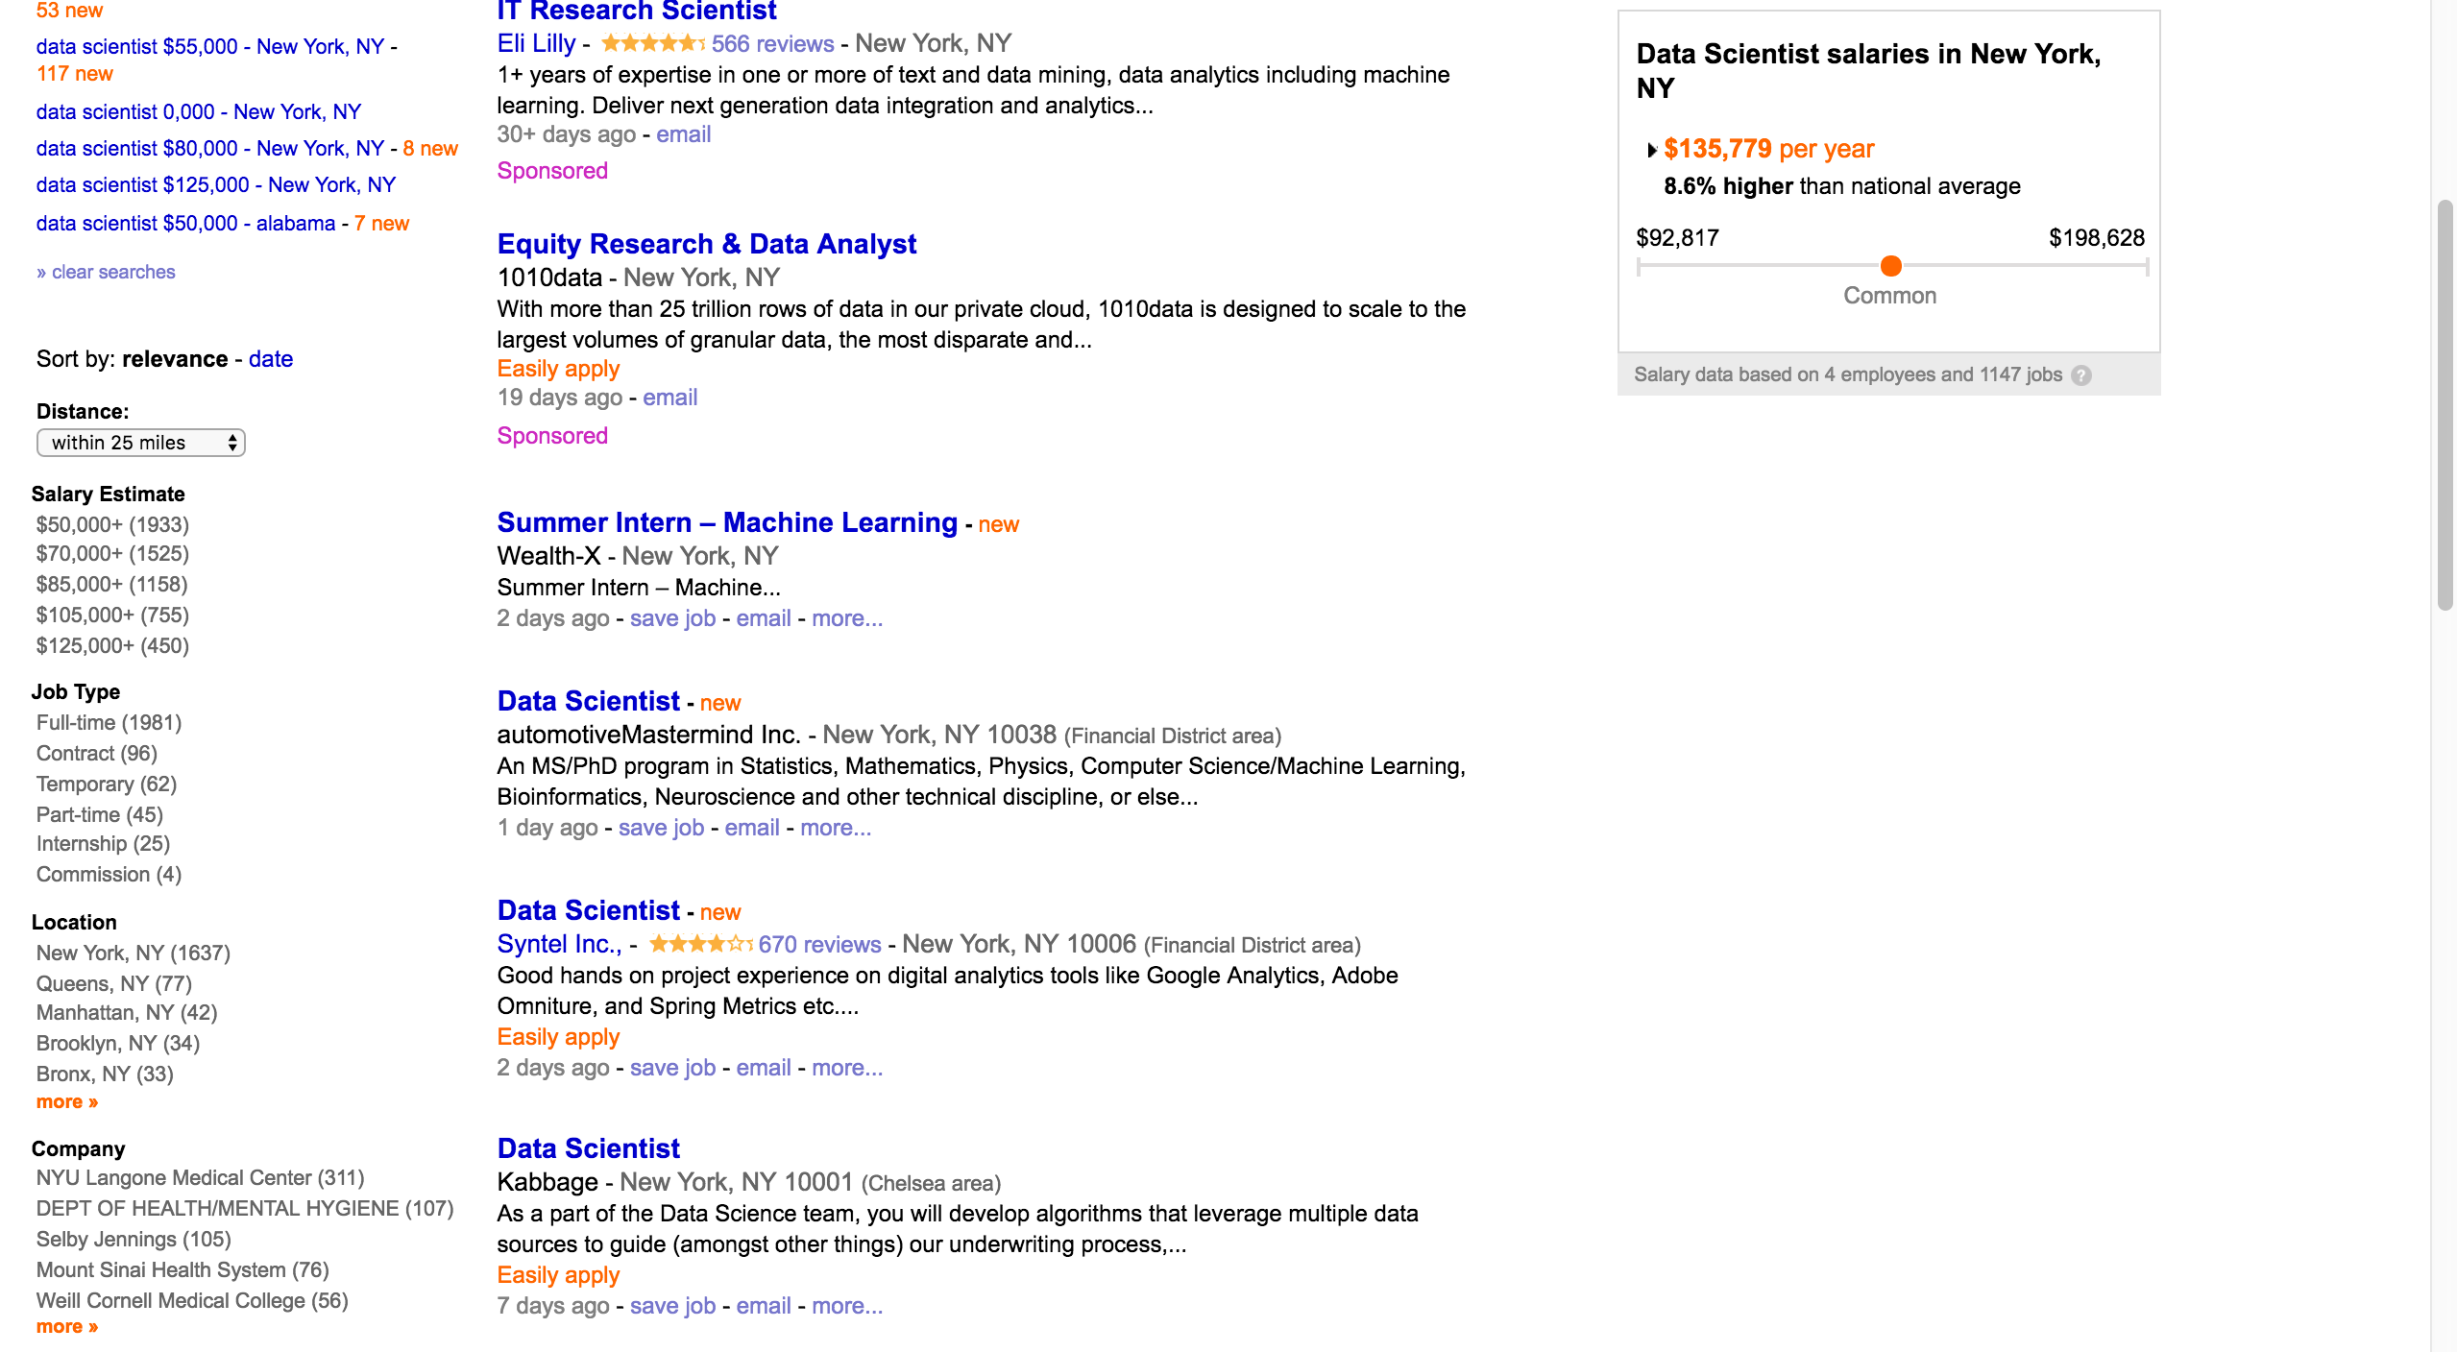
Sponsored with linked company name
Sponsored with not linked company name
Regular with not linked company name
Regular with linked company name

Slide 7
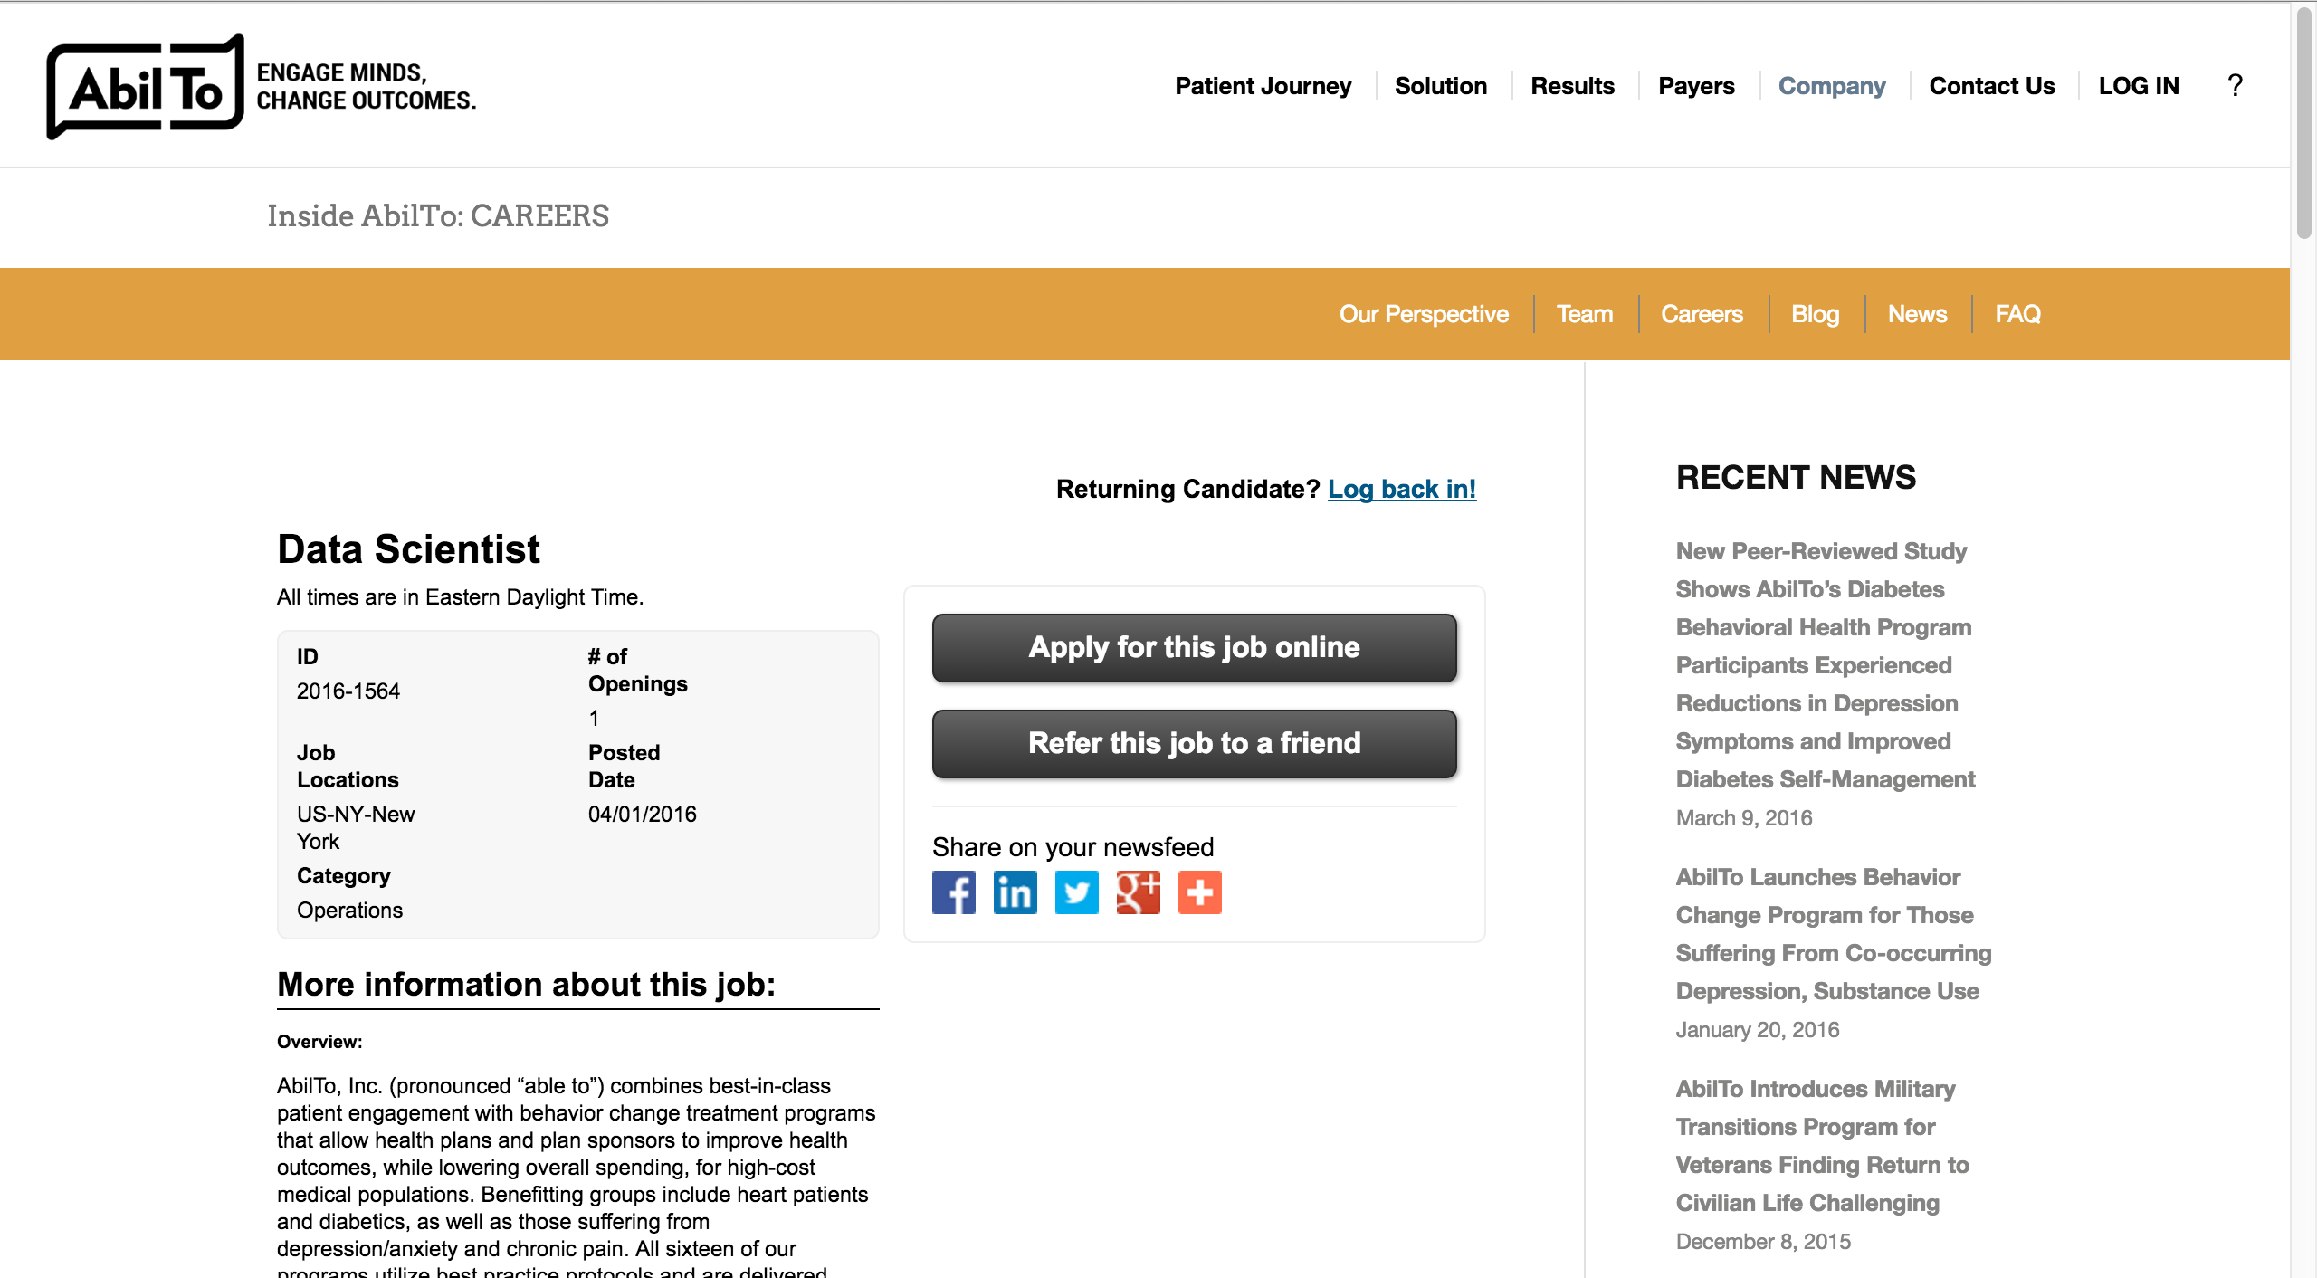
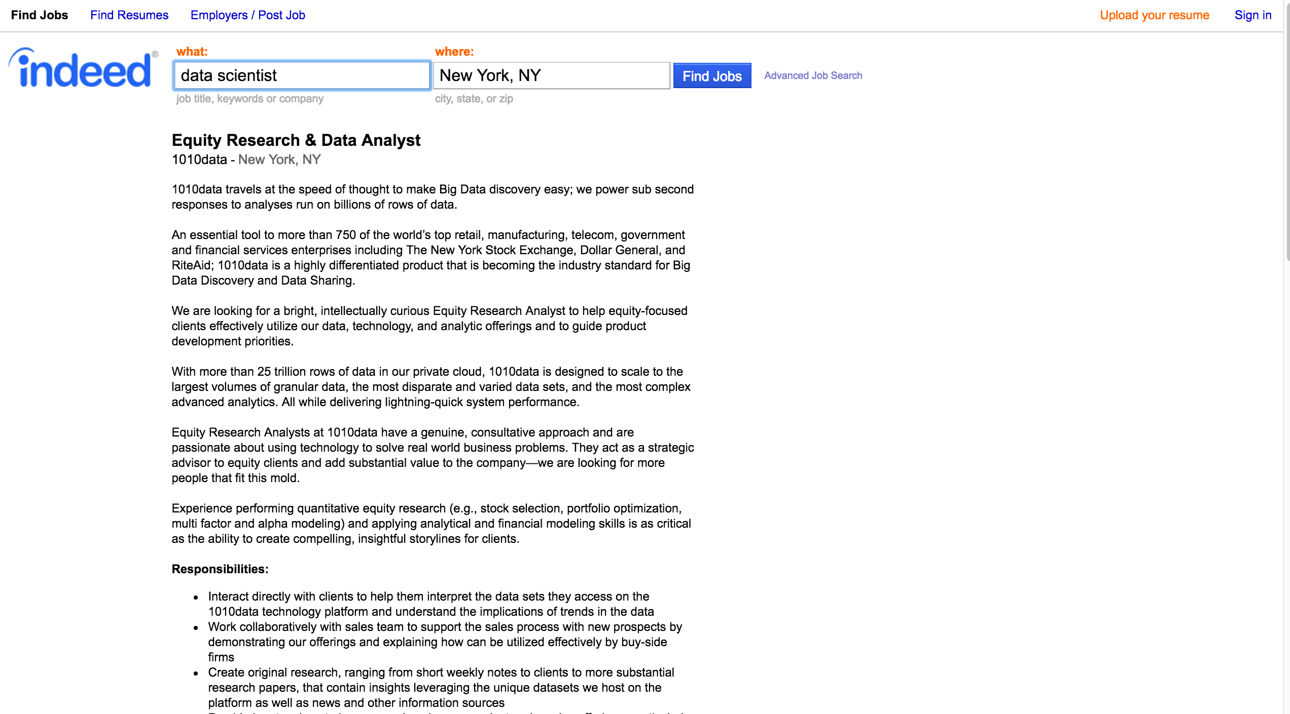


Slide 8
What was right about Dice?
More structured html
Same tag names for job results
Job description pages have the same structure

Slide 9
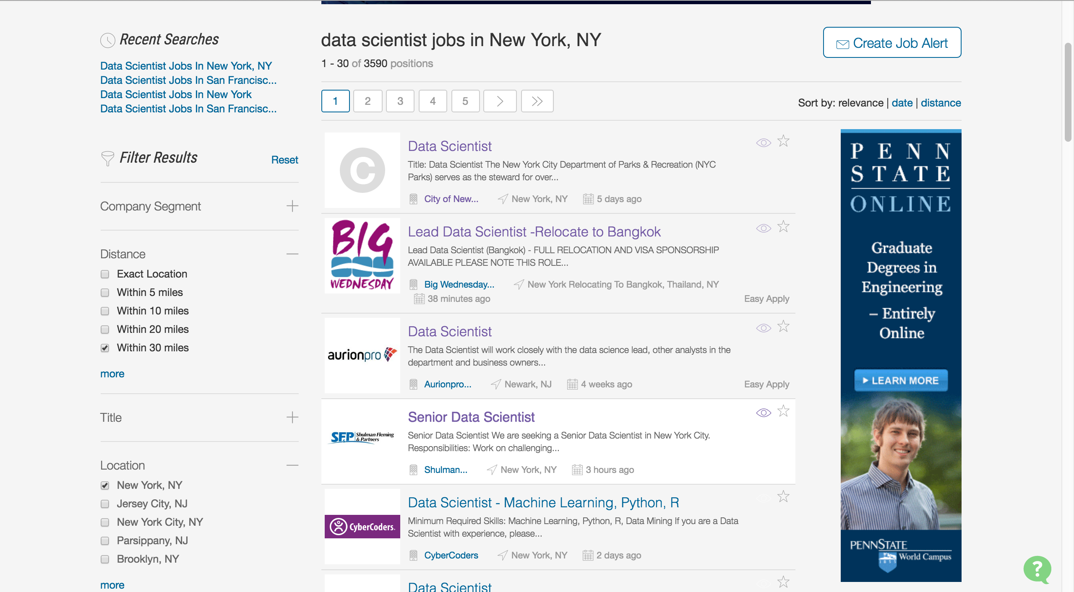

Slide 10
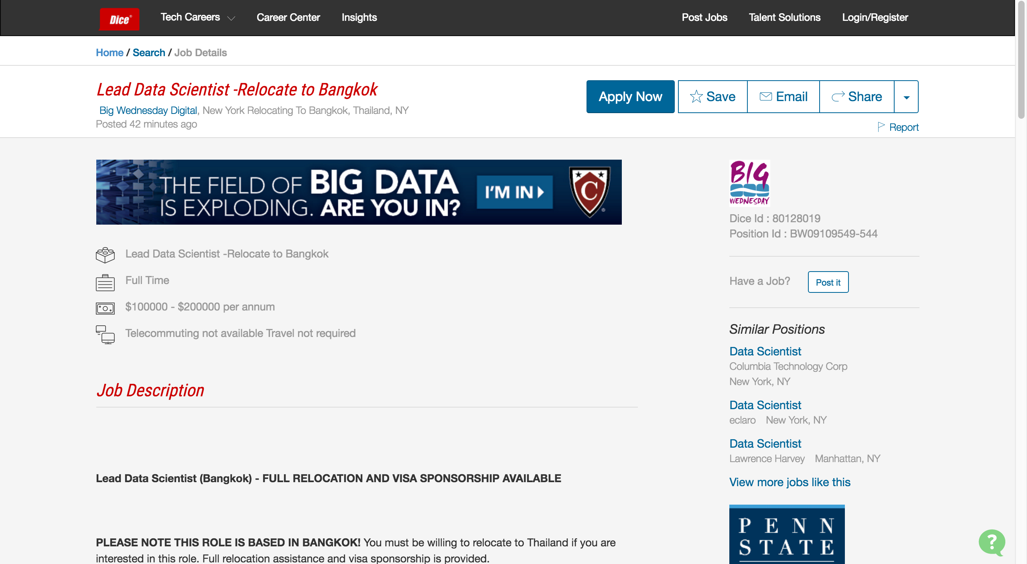

Slide 11
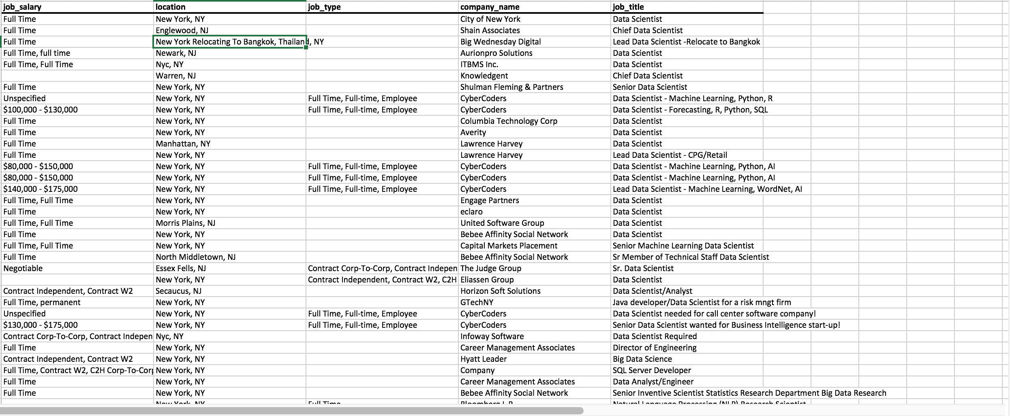
The Scraped Data

Slide 12
The Scraped Data
After lots and lots of data munging and manipulation and etc. etc.
I was able to get 2 bar graphs:
Job counts by company
Number of unique job titles

Slide 13
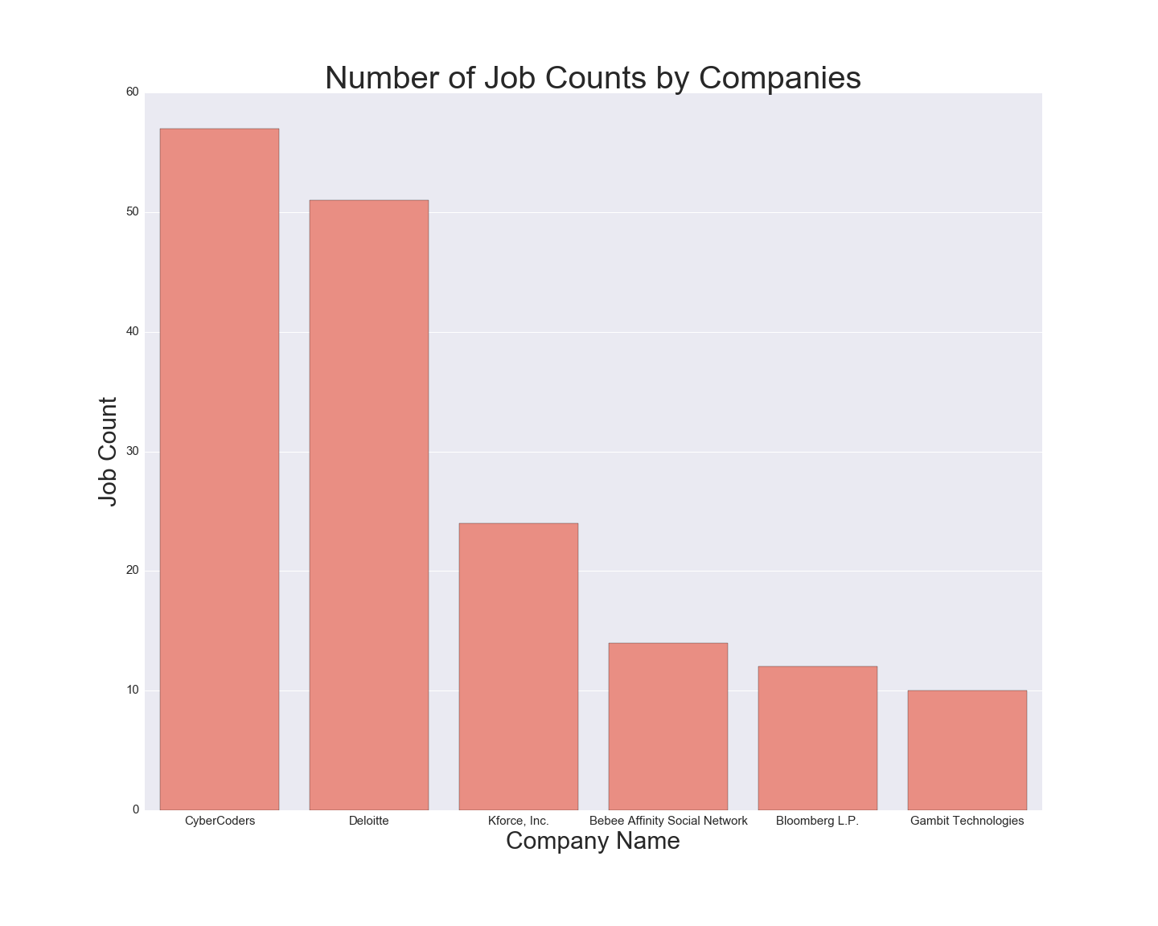
Number of Jobs by Company

Slide 14
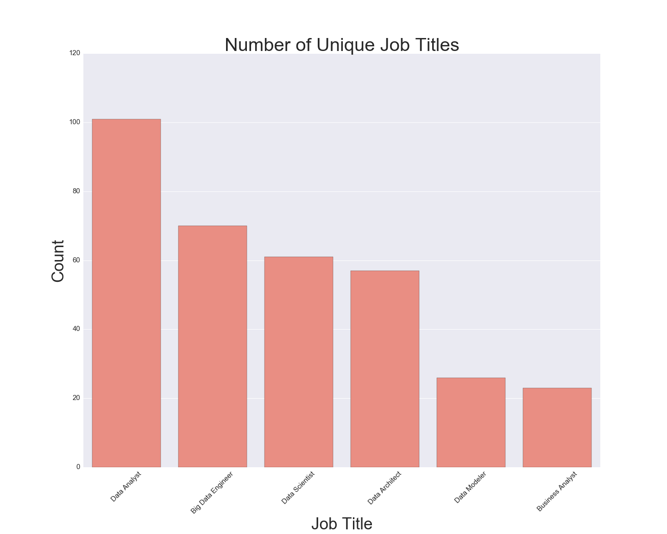
Number of Unique Job Titles

